Slide 1
ET Robocon – 2013 Competition Scoring Analysis
Developer & Architect Competition

Slide 2
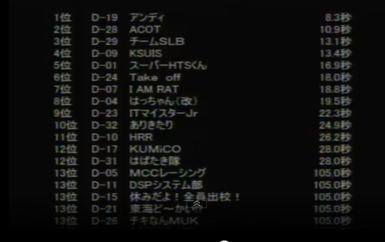
Kyusyu Section 1 – Developer Results
Developer Competition: 34 teams
Architect Competition: 3 teams
Video:
http://www.ustream.tv/recorded/38722395
Watch into 1:02:21-1:03:52 of video
1st Run:
Rank #1: Total 8.3 seconds (In-course)
Rank #2: Total 10.9 seconds
Rank #3: Total 13.1 seconds

Slide 3
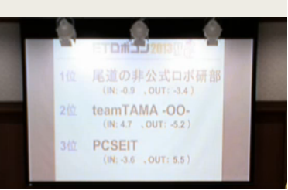
Kyusyu Section 2 – Developer Results
Developer Competition: 34 teams
Architect Competition: 3 teams
Video:
First Half: http://www.ustream.tv/recorded/38721587
Second Half: http://www.ustream.tv/recorded/38724895
Results: http://www.ustream.tv/recorded/38731153
Total:
Rank #1: Total Time = – 4.3 sec
IN: -0.9 seconds , OUT: -3.4 seconds
Rank #2: Total Time = - 0.5 sec
IN: 4.7 seconds , OUT: -5.2 seconds
Rank #3: Total Time = 1.9 seconds
IN: -3.6 seconds , OUT: 5.5 seconds

Slide 4
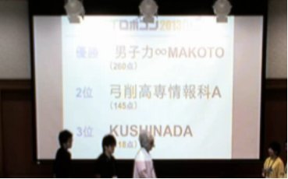
Kyusyu Section 2 – Architect Results
Total: http://www.ustream.tv/channel/etrobochushi
Rank #1: 200 points
Rank #2: 145 points
Rank #3: 118 points

Slide 5
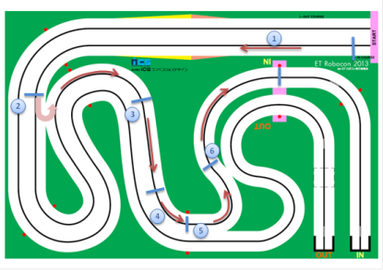
Inner Target Score
Inner | Score | Goal/Target | Team Score
Basic Stage |  | ~35 seconds
Remote Start | 5 seconds | Yes
1st Zone | 5 seconds | No
2nd Zone | 5 seconds | Yes
3rd Zone | 5 seconds | Yes
4th Zone | 5 seconds | Yes
5th Zone (goal of race) | 10 seconds | Yes
Limbo – Single | 5 seconds | No
Limbo – Double | 10 seconds | Yes
Parking | 5 seconds | Yes
Total Score |  | - 45 seconds | - 10 seconds

Slide 6
Outer Target Score
Outer Track | Score | Goal/Target | Team Score
Basic Stage |  | ~48 seconds
Remote Start | 5 seconds | Yes
1st Zone | 5 seconds | Yes
2nd Zone | 5 seconds | Yes
3rd Zone | 5 seconds | Yes
4th Zone | 5 seconds | Yes
5th Zone (goal of race) | 10 seconds | Yes
Seesaw – Single | 5 seconds | No
Seesaw – Double | 10 seconds | Yes
Parking | 5 seconds | Yes
Total Score |  | - 50 seconds | - 2 seconds
TEAM TARGET SCORE: - 12 seconds

